Slide 1
Engagement & Sentiment Analysis: Unveiling Audience Insights

Slide 2
Introduction
Welcome to our comprehensive overview of audience engagement and sentiment analysis. This presentation will delve into the intricate patterns of user interactions and emotional responses captured through our latest data collection efforts. We will explore trends over time, identify key drivers of engagement, and understand the sentiment landscape across different content types. Join us as we unlock valuable insights that can transform our content strategy.

Slide 3
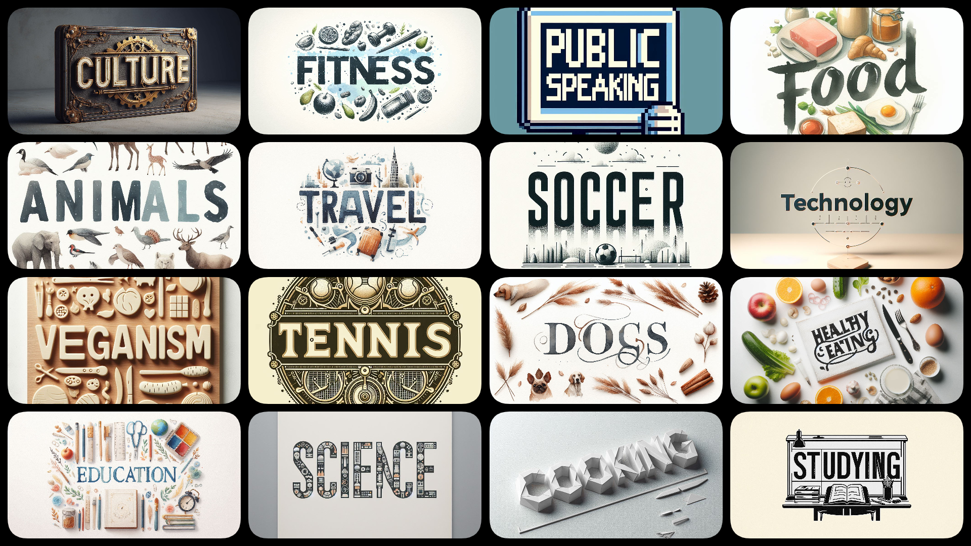
Unique Categories
Culture
Fitness
Public speaking
Food
Animals
Travel
Soccer
Technology
Veganism
Tennis
Dogs
Healthy eating
Education
Science
Cooking
Studying

Slide 4
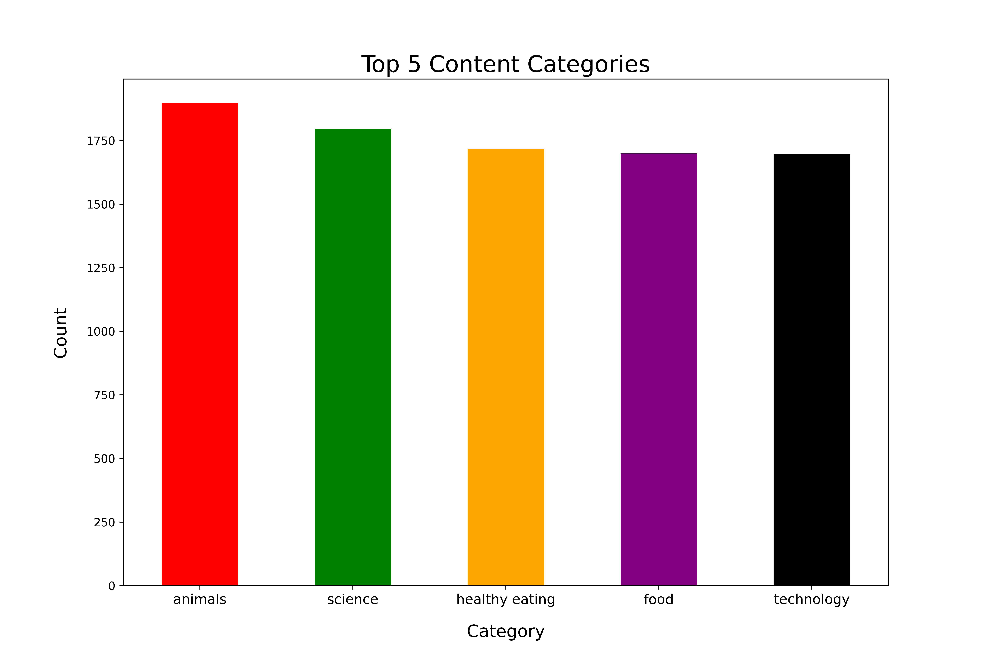
Top 5 Content Categories
Audience Engagement: Our data indicates that 'Animals' is the most popular content category, followed closely by 'Science' and 'Healthy Eating', suggesting high audience engagement in these areas.
Content Strategy: Despite 'Food' and 'Technology' also being in the top five, they have fewer counts, guiding us to focus future content creation on animals, science, and healthy eating to better meet audience interests.

Slide 5
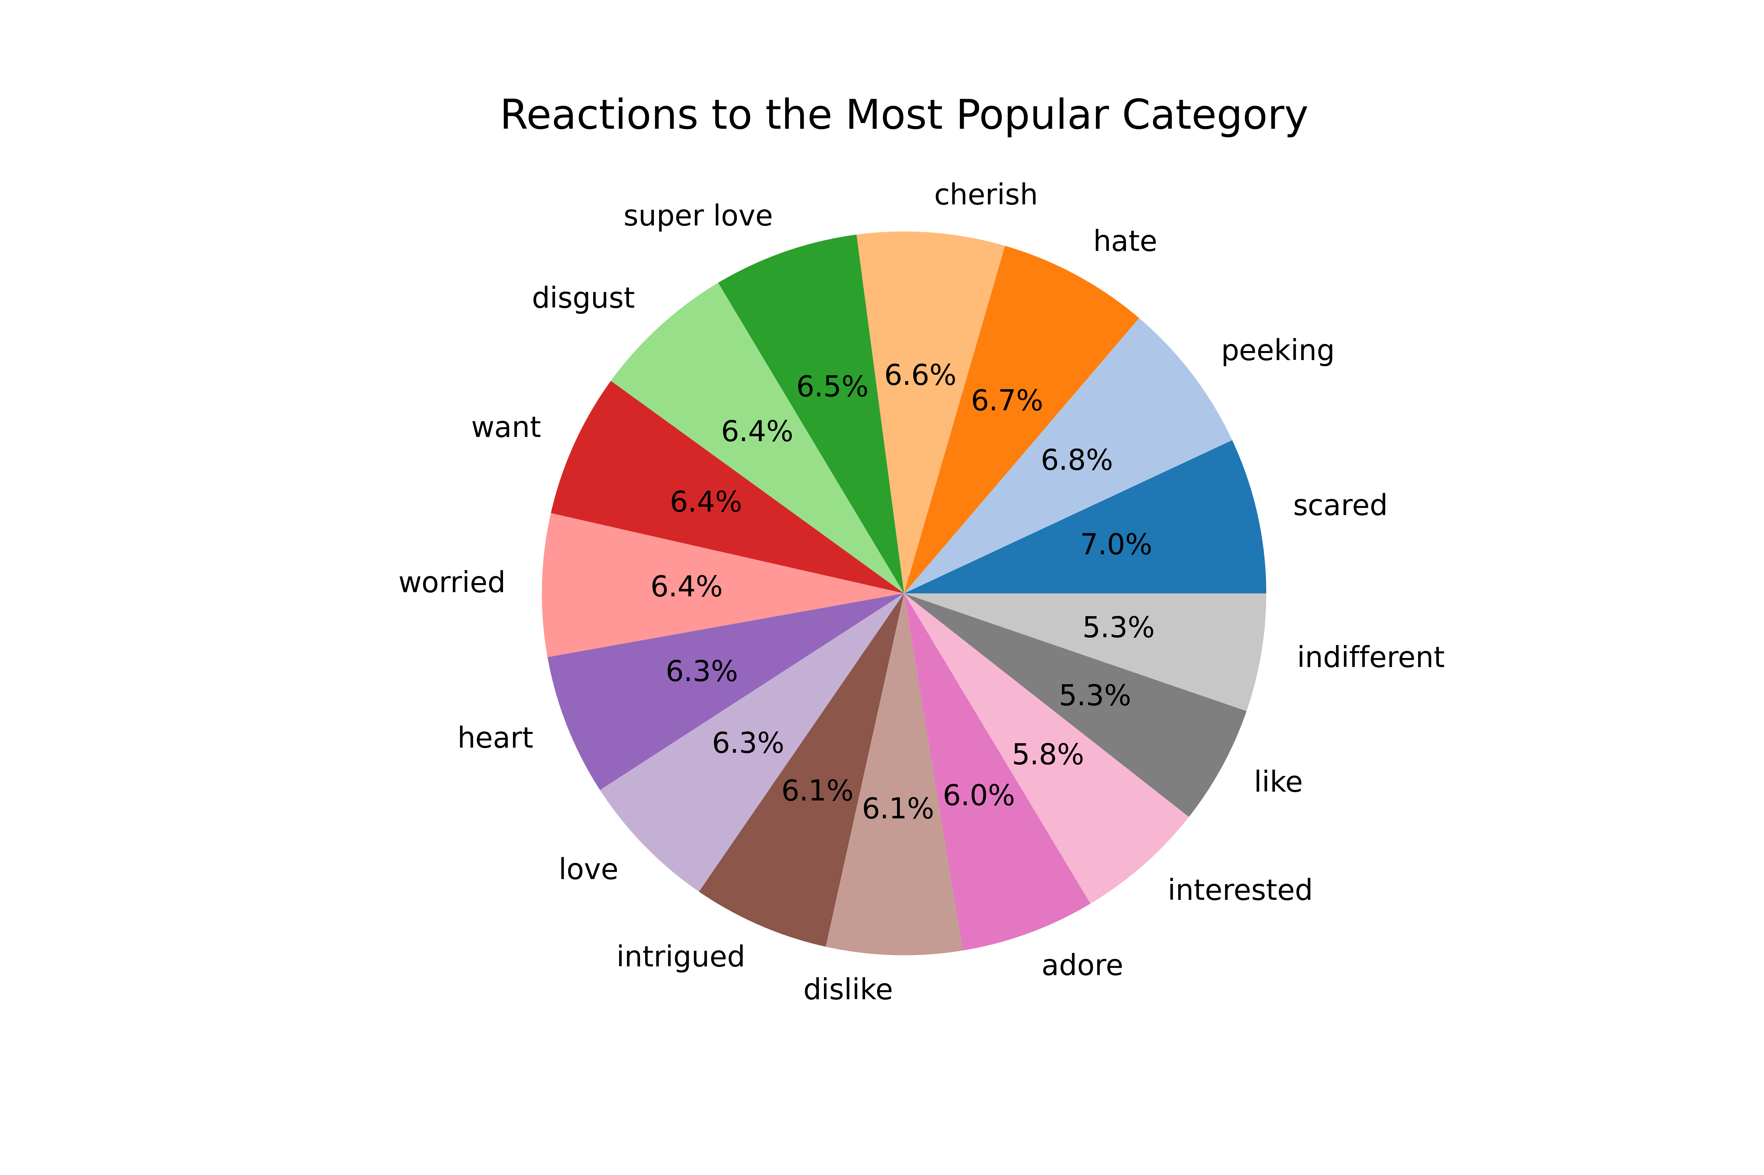
Reactions to the Most Popular Category
Strong Emotional Engagement: The most popular content category elicits strong reactions, primarily 'Cherish', 'Super Love', and 'Hate', indicating significant emotional engagement from our audience.
Content Strategy Refinement: The presence of less frequent reactions like 'Disgust', 'Peeking', 'Scared', and others suggests our content provokes a range of emotions, guiding us to refine our content strategy to enhance positive engagement and address negative feedback.

Slide 6
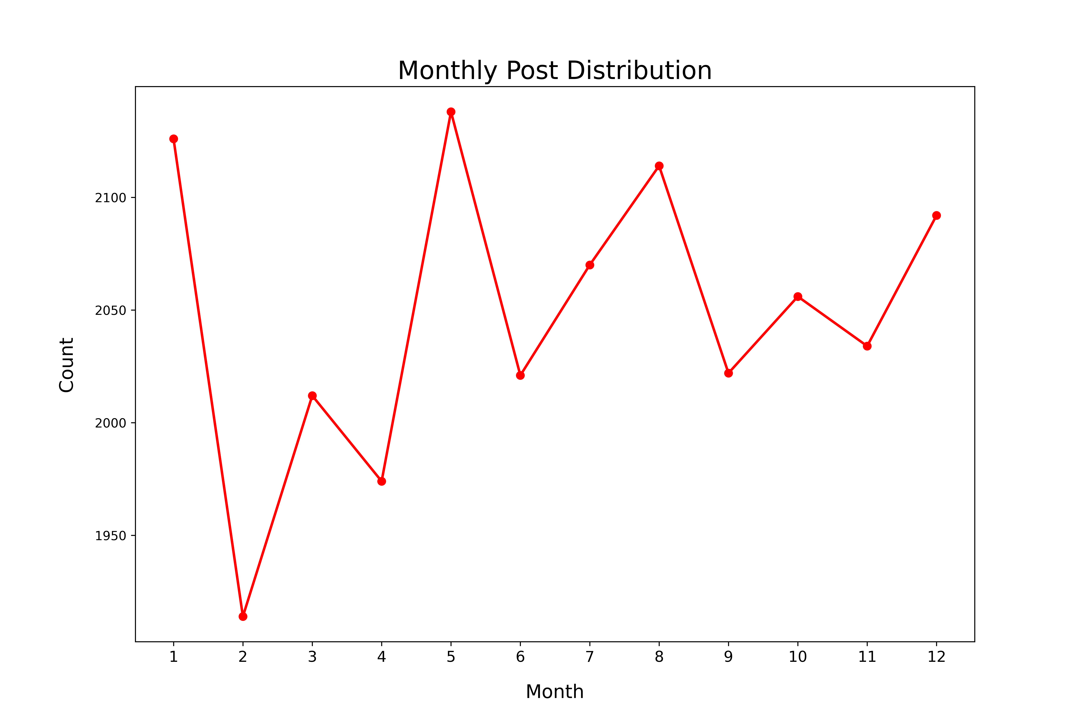
Monthly Post Distribution
Seasonal Posting Fluctuations: Our data reveals varying post frequencies throughout the year, with certain months showing high activity and others showing low activity.
Strategic Content Planning: Understanding these fluctuations allows us to strategically align high-impact content with peak engagement periods for maximum audience reach.

Slide 7
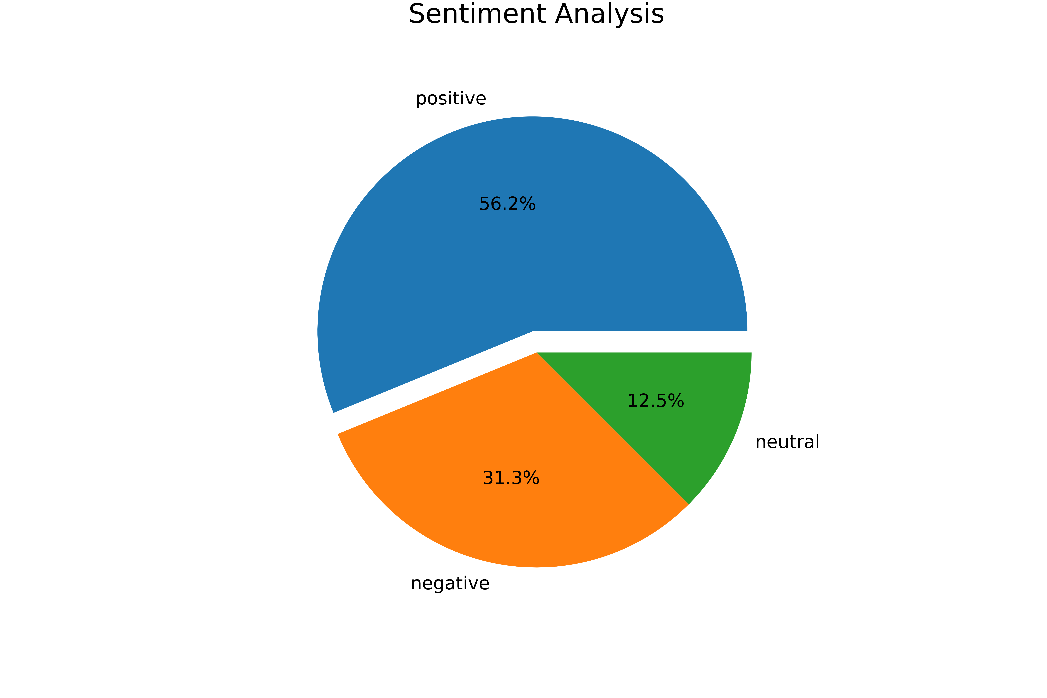
Sentiment Analysis
Positive Sentiment Prevalence: The majority of our content generates positive sentiments (56.2%), showing strong audience approval.
Improvement Areas: With 31.3% negative sentiments, there are clear areas for improvement, while neutral sentiments are minimal (12.5%), indicating our content generally evokes strong reactions.

Slide 8
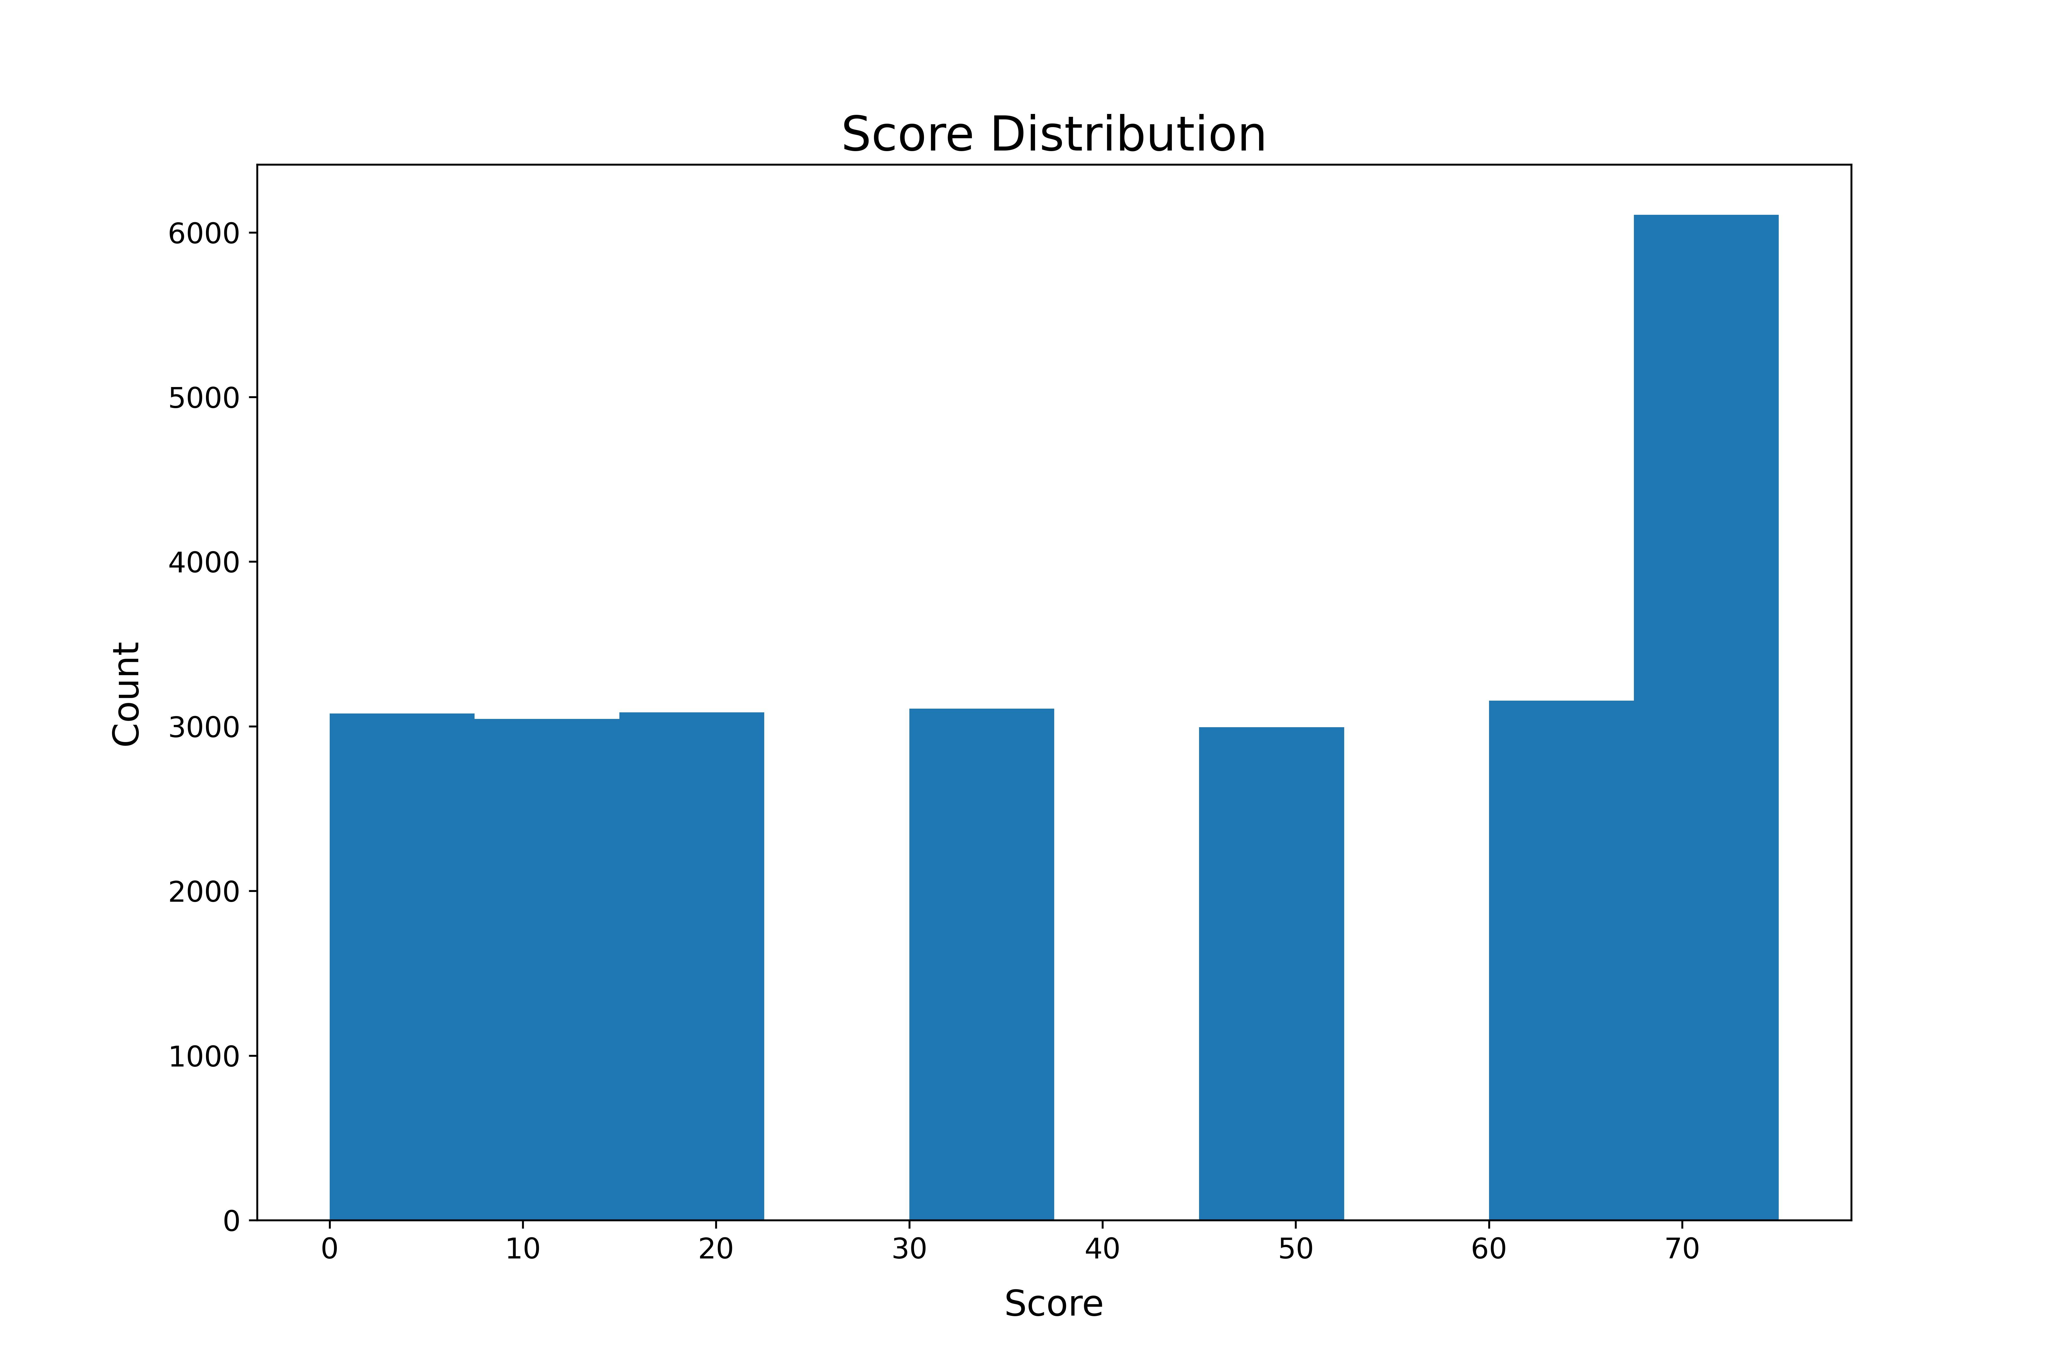
Score Distribution
Bimodal Score Distribution: Our data shows two distinct groups with lower and higher scores, indicating varying levels of content quality or performance.
Improvement Focus: This variation highlights opportunities to enhance content, aiming to shift more scores towards the higher end.

Slide 9
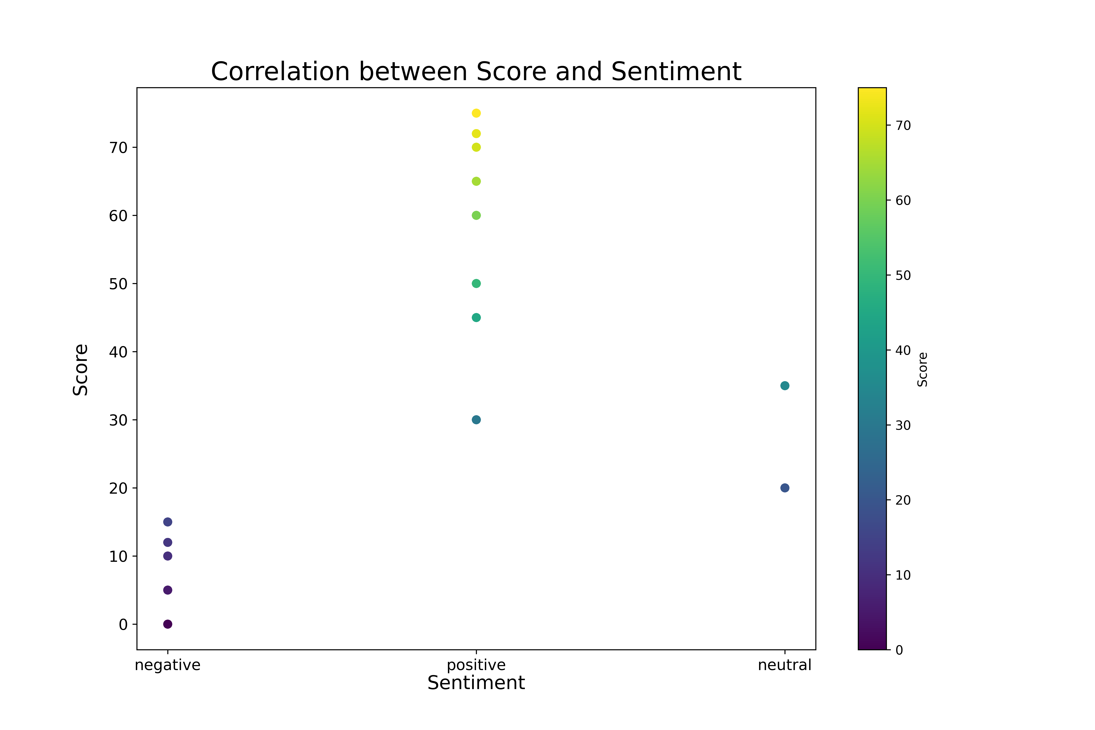
Correlation between Score and Sentiment
Score-Sentiment Trend: Positive sentiment generally correlates with higher scores, while negative sentiment is associated with lower scores, indicating a strong trend in sentiment's impact on scores.
Complex Relationship: The absence of a clear linear pattern suggests a complex relationship between sentiment and score, with various clusters indicating nuanced interactions.
Visual Insights: The color gradient effectively highlights the score distribution across sentiments, helping to quickly assess the overall trends and outliers in the data.

Slide 10
Conclusion
Popular Categories: ‘Animals’, ‘Science’, and ‘Healthy Eating’ are the most engaging content categories.
Emotional Engagement: These popular categories elicit strong reactions, indicating high audience engagement.
Seasonal Fluctuations: Post frequencies vary throughout the year, aligning high-impact content with peak engagement periods can maximize audience reach.
Sentiment Analysis: Majority of sentiments are positive, indicating strong audience approval. However, significant negative sentiments highlight areas for improvement.
Score Distribution: Scores show two distinct groups, indicating varying levels of content quality or performance. This variation presents opportunities for content enhancement.
Sentiment-Score Relationship: Positive sentiment generally correlates with higher scores, indicating sentiment’s impact on scores.
Future Strategy: Insights will guide refinement of content strategy, enhancing aspects that elicit positive sentiments and addressing areas leading to negative sentiments.

Slide 11


